Slide 1
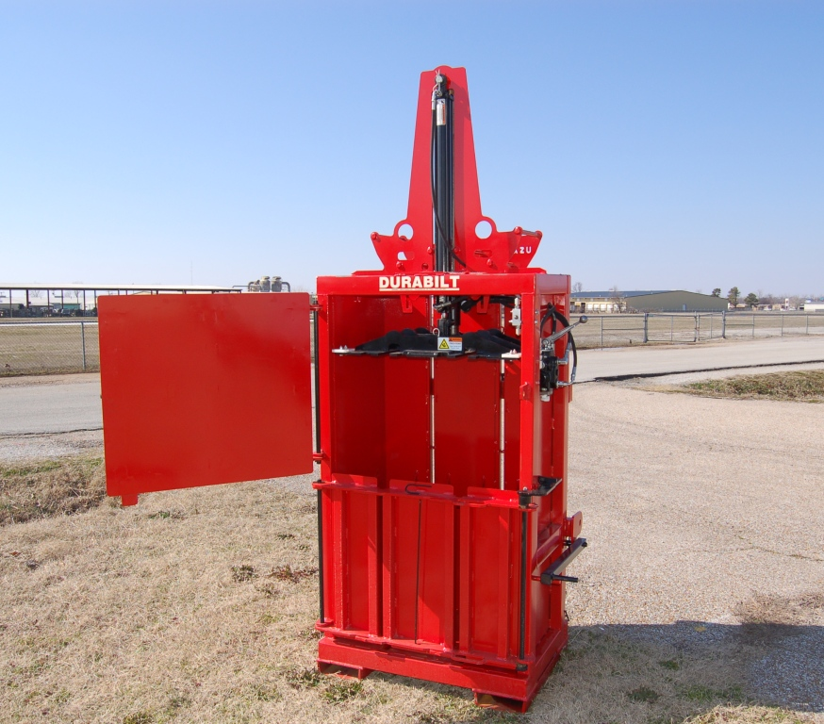
OPERATION MANUAL SWB Compactor

Slide 2
To the Owner/Operator/Dealer
All implements with moving parts are potentially hazardous. There is no substitute for a cautious, safe-minded operator who recognizes the potential hazards and follows reasonable safety practices. The manufacturer has designed this implement to be used with all its safety equipment properly attached to minimize the chance of accidents.
BEFORE YOU START!!
Read the safety messages on the implement as shown in your manual.
Observe the rules of safety and common sense!
!
IMPORTANT SAFETY INFORMATION!
Working with unfamiliar equipment can lead to careless injuries. Read this manual, and the manual for your tractor, before assembly or operating, to acquaint yourself with the machines. It is the owner’s responsibility, if this machine is used by any person other than yourself, is loaned or rented, to make certain that the operator, prior to operating:
1. Reads and understands the operator’s manuals.
2. Is instructed in safe and proper use.
The use of this equipment is subject to certain hazards which cannot be protected against by mechanical means or product design. All operators of this equipment must read and understand this entire manual, paying particular attention to safety and operating instructions, prior to using. If there is something in this manual you do not understand, ask your supervisor, or your dealer, to explain it to you.
Most accidents occur because of neglect or carelessness. Keep all helpers and bystanders twenty-five feet (25’) from an operating implement. Only properly trained people should operate this machine. It is recommended the tractor be equipped with a Rollover Protection System (ROPS) and a seat belt that is used. Always engage parking brake or place transmission in “Park” before dismounting tractor. Never leave equipment unattended with the tractor running.
!
THIS SAFETY ALERT SYMBOL IDENTIFIES IMPORTANT SAFETYWARNING MESSAGES. CAREFULLY READ EACH WARNING MESSAGE THAT FOLLOWS. FAILURE TO UNDERSTAND AND OBEY A SAFETY WARNING, OR RECOGNIZE A SAFETY HAZARD, COULD RESULT IN AN INJURY OR DEATH TO YOU OR OTHERS AROUND YOU. THE OPERATOR IS ULTIMATELY RESPONSIBLE FOR THE SAFETY OF HIMSELF, AS WELL AS OTHERS, IN THE OPERATING AREA OF THE TRACTOR AND ATTACHED EQUIPMENT.
THIS SYMBOL MEANS
– ATTENTION!
– BECOME ALERT!
– YOUR SAFETY IS INVOLVED!

Slide 3
!
EQUIPMENT SAFETY GUIDELINES
Safety of the operator is one of the main concerns in designing and developing a new piece of equipment. Designers and manufacturers build in as many safety features as possible. However, every year many accidents occur which could have been avoided by a few seconds of thought and a more careful approach to handling equipment. You, the operator, can avoid many accidents by observing the following precautions in this section. To avoid personal injury, study the following precautions and insist those working with you, or for you, follow them. The term implement refers to the particular implement this operators manual is written for.
In order to provide a better view, certain photographs or illustrations in this manual may show an assembly with a safety shield removed. However, equipment should never be operated in this condition.
Keep all shields in place. If shield removal becomes necessary for repairs, replace the shield prior to use.
To prevent injury or death, use a tractor equipped with a Roll-Over Protective System (ROPS). Do not paint over, remove or deface any safety signs or warning signs on your equipment. Observe all safety signs and practice the instruction on them.
Never exceed the limits of a piece of machinery. If its ability to do a job, or to do so safely, is in question - DON’T TRY IT.
Do not modify the equipment in any way. Unauthorized modification may impair the function and/or safety and could affect the life of the equipment.
In addition to the design and configuration of this implement, including Safety Signs and Safety Equipment, hazard control and accident prevention are dependent upon the awareness, concern, prudence, and proper training of personnel involved in the operation, transport, maintenance, and storage of the machine. Refer also to Safety Messages and Operation instruction in each of the appropriate sections of the Tractor and Implement Manuals.
Pay close attention to the Safety Signs affixed to the Tractor and the Implement.
Replace any CAUTION, WARNING, DANGER or instruction safety sign that is not readable or is missing. Location of such safety signs is indicated in this booklet.
Never use alcoholic beverages or drugs which can hinder alertness or coordination while operating this
equipment. Consult your doctor about operating this machine while taking prescription medications.
Review the safety instructions with all users annually.
This equipment is dangerous to children and persons unfamiliar with its operation. The operator should be a responsible adult familiar with farm machinery and trained in this equipment’s operations.
Do not allow persons to operate, assemble or service this implement until they have read this manual and have developed a thorough understanding of how to operate, assemble and service this implement.

Slide 4
!
SAFETY SIGNS
Keep safety signs clean and legible at all times.
Replace safety signs that are missing or have become illegible.
Replaced parts that displayed a safety sign should also display the current sign.
Safety signs are available from your Distributor or Dealer Parts Department or the factory.
!
PERSONAL PROTECTION
Personal protection equipment including hard hat, safety glasses, safety shoes, and gloves are recommended during assembly, installation, operation, adjustment, maintaining, repairing, removal, or moving the implement. Do not allow long hair, loose fitting clothing or jewelry to be around moving parts.
!
PROLONGED EXPOSURE TO LOUD NOISE MAY CAUSE PERMANENT HEARING LOSS! Tractors with or without attachments can often be noisy enough to cause permanent, partial hearing loss. We recommend that you wear hearing protection on a full-time basis if the noise in the Operator’s position exceeds 80db. Noise over 85db on a long-term basis can cause severe hearing loss. Noise over 90db adjacent to the Operator over a long-term basis may cause permanent, total hearing loss. NOTE: Hearing loss from loud noise (from tractors, chain saws, radios, and other such sources close to the ear) is cumulative over a lifetime without hope of natural recovery.
Ensure implement is properly mounted, adjusted and in good operating condition.
Please remember it is important that you read and heed the safety signs on the implement, and the safety rules set forth. Clean or replace all safety signs if they cannot be clearly read and understood. They are there for your safety as well as the safety of others. The safe use of this machine is strictly up to you, the operator.
All things with moving parts are potentially hazardous. There is no substitute for a cautious, safe-minded operator who recognizes potential hazards and follows reasonable safety practices. The manufacturer has designed this implement to be used with all of its safety equipment properly attached, to minimize the chance of accidents. Study this manual to make sure you have all safety equipment attached.

Slide 5
!
Safety Instructions
Hydraulic oil under high pressure can penetrate the skin. Make sure that all operating and service personnel know that in the event hydraulic fluid penetrates the skin, it must be surgically removed within a few hours by a doctor familiar with this form of injury, or gangrene may result.
If a safety shield or guard is removed for any reason, it must be replaced before the machine is again operated.
Before servicing the machine, engage the parking brake or place the transmission in “Park”, shut off the tractor and remove the key. Relieve all hydraulic pressure in lines.
When the use of hand tools is required to perform any part of assembly, installation, adjustment, maintaining, repairing, removal, or moving the implement, be sure the tools used are designed and recommended by the tool manufacturer for that specific task.
Personal protection equipment including hard hat, safety glasses, safety shoes, and gloves are recommended during assembly, installation, operation, adjustment, maintaining, repairing, removal, or moving the rake. Do not allow long hair, loose fitting clothing or jewelry to be around moving parts.
Always use two people or a mechanical lift device to handle heavy, unwieldy components during assembly, installation, removal, or moving the implement or components.
Never place any part of your body where it would be in danger if movement should occur during assembly, installation, operation, maintaining, repairing, removal, or moving the implement.
Never place yourself between the tractor and implement while implement is in operation.
Do not walk or work under a raised wings unless it is securely blocked or held in position. Do not depend on the tractor hydraulic system to hold the wing or attachment in place.
Never leave wings in the partially raised position. Always lower wings to the ground or to the transport position when storing.
Always install the transport lock pins before transporting or storing the implement in the transport position.
A heavy load can cause instability of the tractor. Use extreme care during travel. Slow down on turns and watch out for bumps.

Slide 6
Be especially cautious on hill sides. Always operate tractor at a safe speed for the conditions experienced.
Do not allow riders on the rake or tractor at any time. There is no safe place for any riders.
Before you operate the implement, check over all pins, bolts and connections to be sure all are securely in place.
Replace any damaged or worn parts immediately.
Do not allow anyone who is not familiar with the safety rules and operation instructions to use this implement.
Never allow children to operate or be around this implement.
Use safety chain when towing implement.
Do not operate implement on steep hillsides.
Watch out for low overhead electrical wires and limbs when operating or transporting the implement. Check clearance of doorways when entering a building.
WARNING! NEVER INSERT FINGER IN A HOLE TO CHECK ALIGNMENT.
Always use care when operating implement.
ALWAYS OBEY SAFETY WARNINGS!
!
!

Slide 7
!
TRANSPORT SAFETY
Comply with state and local laws governing highway safety and movement of farm machinery on public roads.
The use of flashing amber lights is acceptable in most localities. However, some localities prohibit their use. Local laws should be checked for all highway lighting and marking requirements.
When driving the tractor and equipment on the road or highway under 20 mph (32 kph) at night or during the day, use flashing amber warning lights and a slow moving vehicle (SMV) identification emblem. Except when prohibited by law.
Watch out for low overhead electrical wires and limbs when operating or transporting the implement. Check clearance of doorways when entering a building.
Always be sure the implement is in the proper raised position for transport.
Reduce speed when transporting mounted implements to avoid bouncing and momentary loss of steering control.
Plan your route to avoid heavy traffic.
Always shut off hydraulic transport lock valves before transporting.
Do not drink and drive!
Watch for traffic when operating near or crossing roadways.
Turn curves or go up or down hills only at a low speed and at a gradual steering angle. Make certain that at least 20% of the tractor’s weight is on the front wheels to maintain safe steerage. Slow down on rough or uneven surfaces, and loose gravel.
Use extreme care and maintain minimum ground speed when transporting on hillside, over rough ground and when operating close to ditches or fences. Be careful when turning sharp corners.
Never allow riders on either tractor or implement. Falling off can kill.
Be a safe and courteous driver. Always yield to oncoming traffic in all situations, including narrow bridges, intersections, etc.
Do not exceed 20 mph (32 kph). Reduce speed on rough roads and surfaces.
Never use PTO spline adapters.

Slide 8
!
STORAGE SAFETY
Following operation, or when unhooking, stop the tractor, set the tractor brakes, lower wings all the way to the ground and release hydraulic pressure, disengage the PTO, shut off the engine and remove the ignition keys.
Store the unit in an area away from human activity.
Do not permit children to play on or around the stored unit.
Make sure all parked machines are on a hard, level surface and engage all safety devices.
If blocking is used, make sure it is solid and secure before leaving area.
Never stand between tractor and implement when tractor is being backed up to implement to hitch up implement.
OPERATING INSTRUCTIONS
ATTACHING SWB COMPACTOR TO THE TRACTOR
Before hitching the compactor to the tractor make sure both are in good operating condition. Slowly back up to the compactor until the tractor quick hitch or lift arms lines up with the hitch pins on the compactor. Insert proper size pin and retaining clip. Attach top link and adjust. Make sure all pins and keepers are properly installed and check all bolts and fasteners for tightness before using compactor. Plug in the hydraulic remotes, Note: If compactor only operates in one direction then reverse the remotes.
Adjust top link so compactor is level when lowered to the ground.
Warning: do not stand between tractor and implement while tractor is being backed up to implement!
!
!
Warning: do not stand between or reach into the area between the tractor and implement while implement is being raised or lowered!
!
Warning: do not exceed the tractor manufacturers weight rating on the front or rear mount!

Slide 9
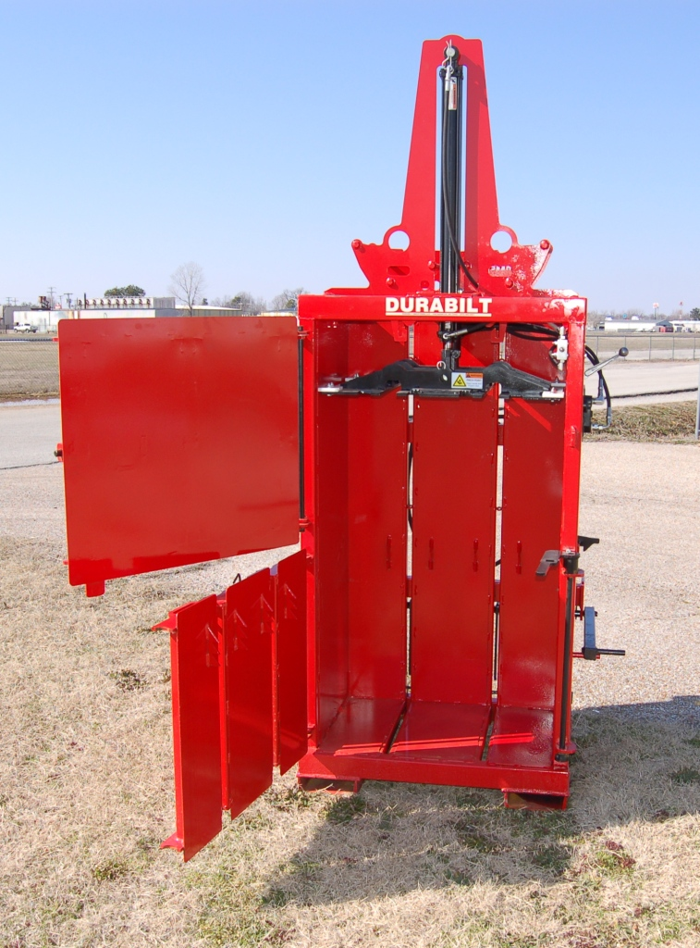
WARNING: WHEN ATTACHING THE COMPACTOR TO THE TRACTOR LIFT THE COMPACTOR SLOWLY TO THE FULL UP POSITION TO MAKE SURE IT WILL NOT HIT THE TRACTOR CAB OR REAR GLASS WHEN THE GLASS IS OPEN!
!
Operation of the SWB Compactor
Warning: always set parking brake and or put the transmission in park before leaving the tractor seat!
Plug in hydraulic quick connectors of compactor into hydraulic remote connectors on the tractor. If compactor operates in only one direction then reverse the connection of the remotes. Lock tractor remote so the oil flows continuously. Check tractor operation manual on continuous flow.
WARNING: Never operate compactor with either door open!
CAUTION: Fill compactor evenly and do not load solid objects into compactor or damage can result!
WARNING: Do not stand in front of compactor doors or allow anyone else to stand in front of compactor doors while operating!

Slide 10
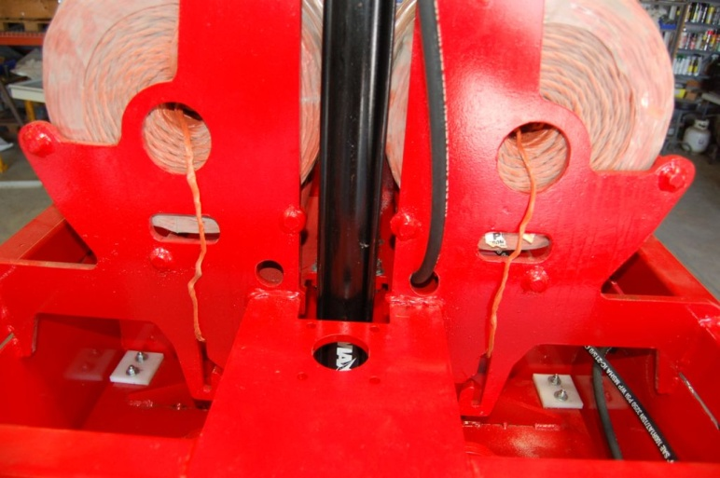
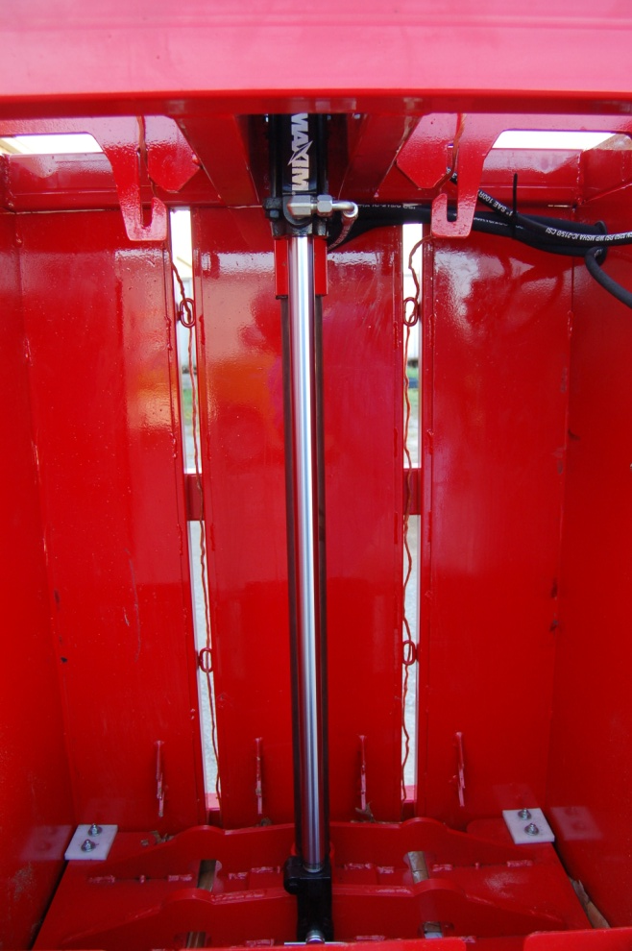
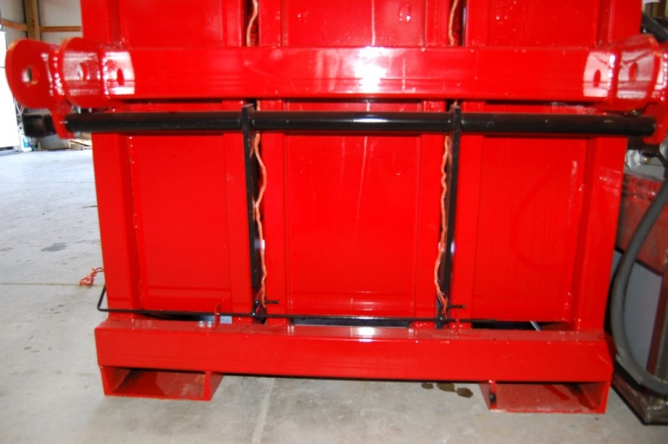
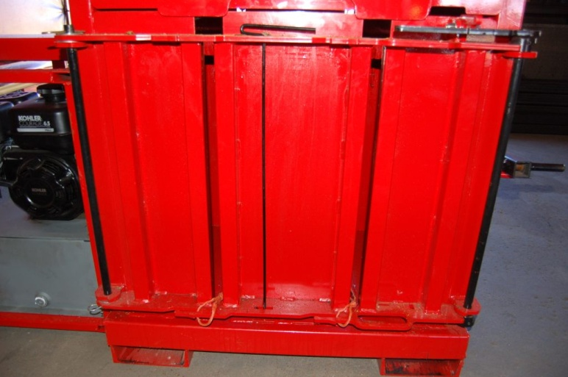
Feed the twine as shown
Step #1
Step #2
Twine goes on inside of braces as shown
Twine goes thru all 4 eyelets
Step #3
Slide twine release into the closed position as shown
Twine goes alongside kicker plates and behind twine release ears
Step #4
Step #5
Close and latch lower door. Feed twine thru slot, tie a loop in the end and hook it on the tang as shown
Twine goes on inside of braces as shown
Twine goes alongside kicker plates and behind twine release
Twine comes thru slot in door and over the plate as shown

Slide 11
Hydraulic Ram
Upper Door
Control Valve
Twine Slots
Lower Door Latch
Twine Hook
Bale Ejector Lever
Lower Door
Twine Release
LOADING THE SWB COMPACTOR
Before loading the compactor make sure the ram is raised all the way up and twine is fed thru compactor and hooked on the lower cross bar on the lower door. Make sure the lower door is latched properly. Load compactor evenly and do not insert large solid objects like concrete blocks or boards into compactor. Fill compactor all the way to the bottom of the ram. Close the top door and lower ram all the way down then reverse the handle and raise it all the way up. Open top door and repeat the process until the ram will not go below the material retention teeth on the inside of the lower door. Leave the ram down on the last stroke when the compactor is full. Open top door with the ram all the way down putting pressure on the bale. Tie off the bale as shown on the following page. Never allow the compactor to get so full that the ram stops above the lower door!
Warning: Never operate the compactor with any door open! If ram operates with any door open repair safety valve and, or replace any safety feature as needed. Keep hands away from moving parts and do not stand in front of compactor while operating!
Warning: Never put containers with liquid in them inside compactor! Make sure all containers are completely empty before compacting them!
!
!

Slide 12
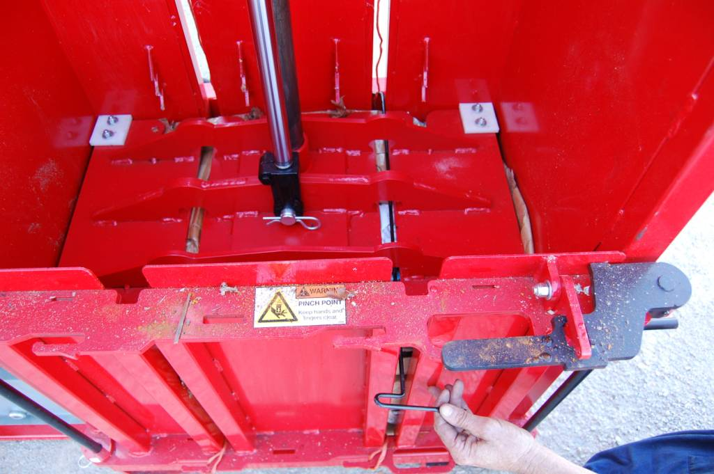
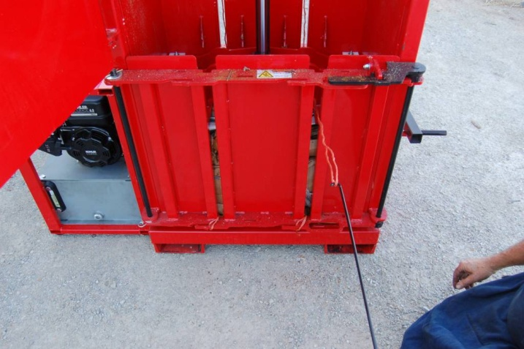
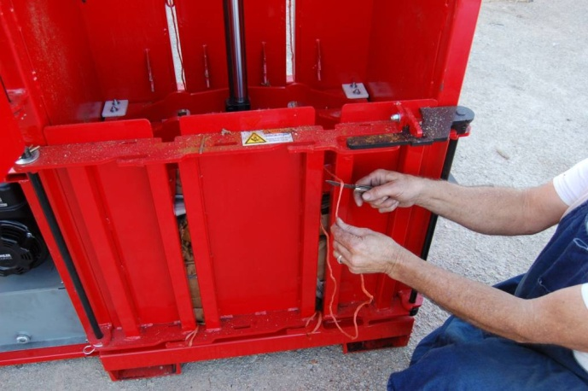
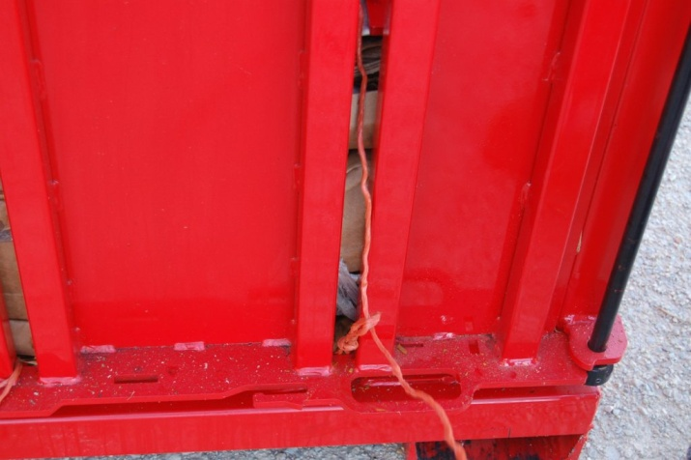
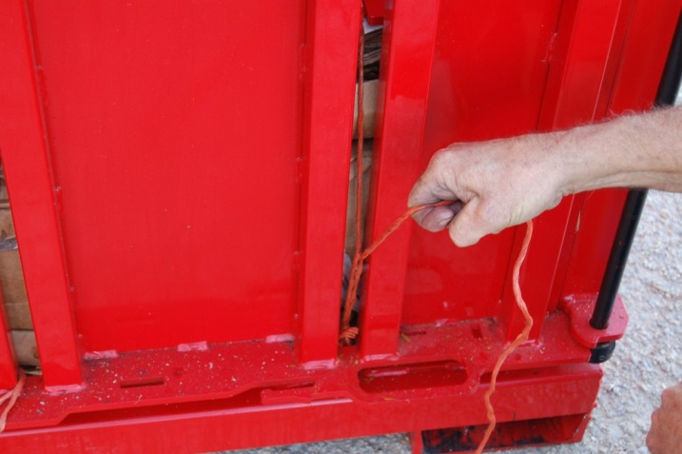
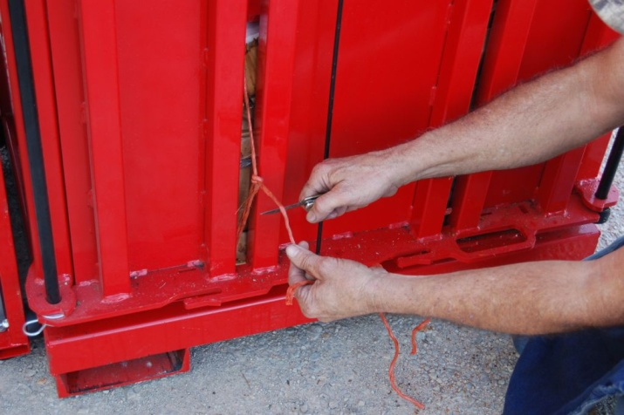
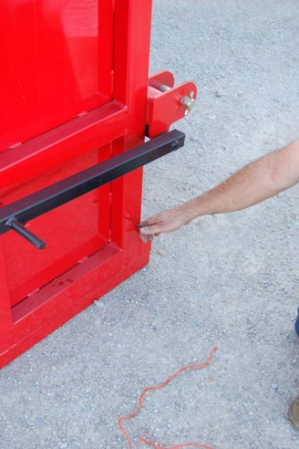
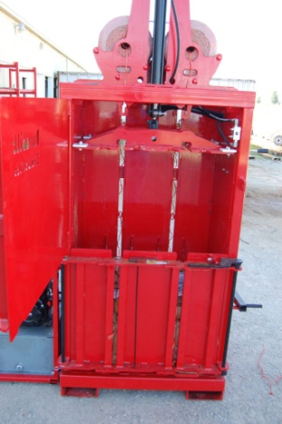
Tying the twine on the bale
Step #1
Remove twine hook from lower door
Step #2
Feed twine hook thru lower door then thru the twine slot in the press plate and hook the twine as shown
Step #3
Step #4
Cut end of twine that is attached to the twine ball on top of the compactor but make sure to leave enough length to reach the loop hooked to the lower door
pull twine out thru slot in lower door as shown
Step #5
Step #6
Feed loose end thru loop as shown
pull twine tight
Step #7
Tie the loose end to the loop and cut off the excess then repeat the process on the other side.
Step #8
Step #9
After both twines are tied pull the twine release all the way out
Retract ram all the way up and make sure the twine is not caught on anything

Slide 13
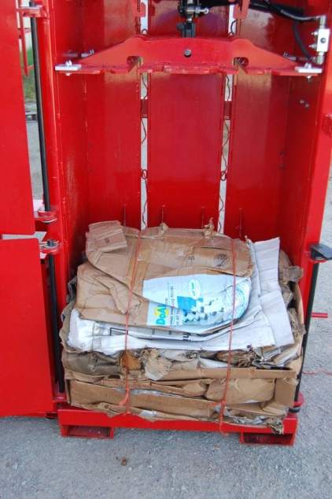
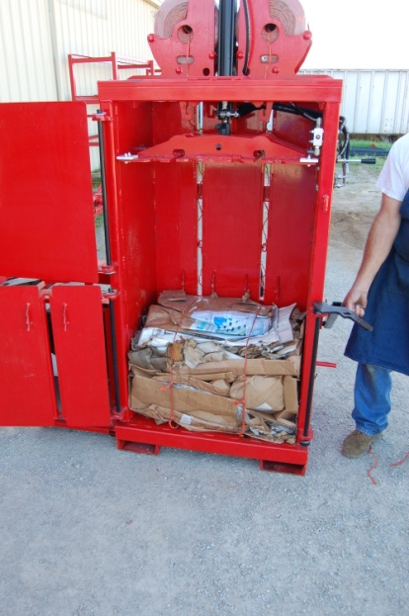
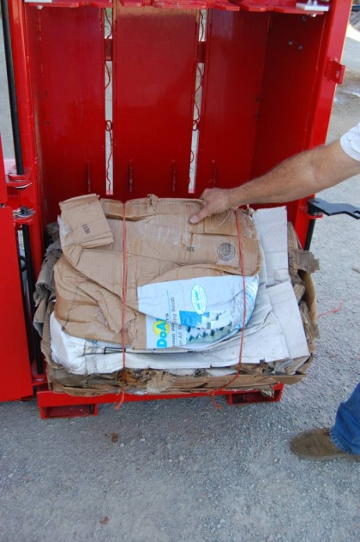
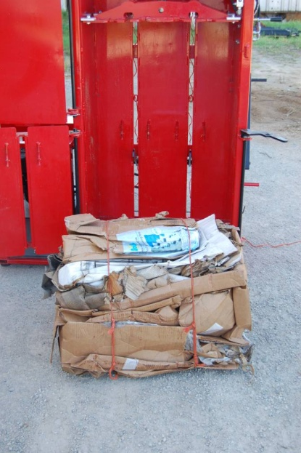
WARNING: Be careful not to stand in front of the compactor when unlatching the lower door as it is under pressure and can spring open!
WARNING: Bales are heavy, use proper lifting equipment to safely move bales.
UNLOADING THE SWB COMPACTOR
Step #10
Carefully unlatch lower door and swing it fully open.
Caution: Do not stand in front of door when unlatching as it is under pressure and could spring open unexpectedly!
Open upper door and make sure twine is properly tied on bale.
Step #11
Step #12
Step #13
Use proper lifting equipment to move bales as they can be quite heavy depending on the material that they contain
Rotate bale ejection handle upward, this will tip the bale and push it part of the way out
Reach in and roll bale out of compactor. Caution: be sure to keep your feet out from under bale as it rolls out
Step #14
!
!

Slide 14
(Located on rear of compactor above top link bracket)
WHEN LIFTING ANY THREE POINT IMPLEMENT FOR THE FIRST TIME ALWAYS DO SO SLOWLY TO MAKE SURE IT WILL NOT HIT THE TRACTOR CAB OR REAR GLASS WHEN OPEN. ON FRONT MOUNTS MAKE SURE IT DOES NOT HIT THE FRONT OF THE TRACTOR OR HOOD.
260054
(located on top of lower door or on front of press plate assembly)
PINCH POINT.
Keep hands and fingers clear.
260045

Slide 15
DURABILT
Durabilt Industries, LLC • Pocahontas, AR 72455 • Phone 870-892-4501

